Slide 1

Next Hikes IT Solutions
Next Hikes | Elevating Digital Experiences
Next Hike IT Solutions is a growing IT services and solutions company that focuses on delivering innovative, reliable, and cost-effective technology solutions. The company specializes in providing end-to-end IT services, helping businesses improve efficiency, productivity, and digital transformation.
Next Hike IT Solutions is committed to quality, client satisfaction, and continuous innovation, making it a trusted technology partner for organizations across various industries.

Slide 2
Introduction – Roshan Kumar
My name is Roshan Kumar, and I am passionate about data analysis and dashboard development.
I have hands-on experience in Excel, Power Query, Pivot Tables, and VBA Macros.
I enjoy working on data cleaning, transformation, and automation to convert raw data into meaningful insights.
I focus on building interactive, user-friendly, and scalable dashboards for effective decision-making.
This project showcases my ability to handle end-to-end data workflows, from raw datasets to professional dashboards.

Slide 3
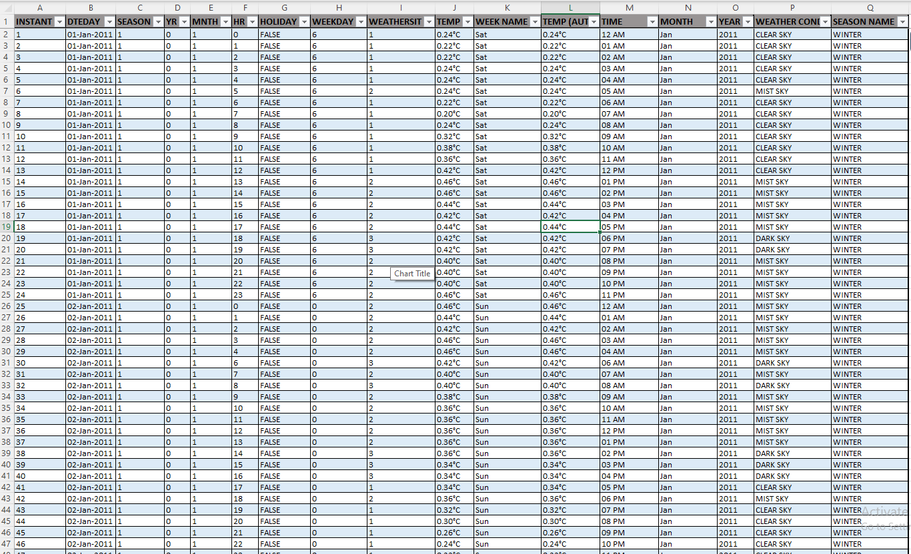
Dataset_1 – Data Preparation & Automation
Initially, Dataset_1 was converted into a structured table and then modified as per analysis requirements.
Temperature values were formatted in Degree Celsius (°C) using the Format Cells option.
Time, Month, and Year were extracted into separate columns using TEXT and TIME functions to ensure accurate values.
Weather and Season columns were populated using the SWITCH function, making the system dynamic—any new season added in the future will be picked automatically.
Missing (blank) temperature values were handled by creating a new column where blanks are automatically replaced with the Mean (Average) temperature value.
This ensures data consistency, accuracy, and a fully automated workflow for future updates.

Slide 4
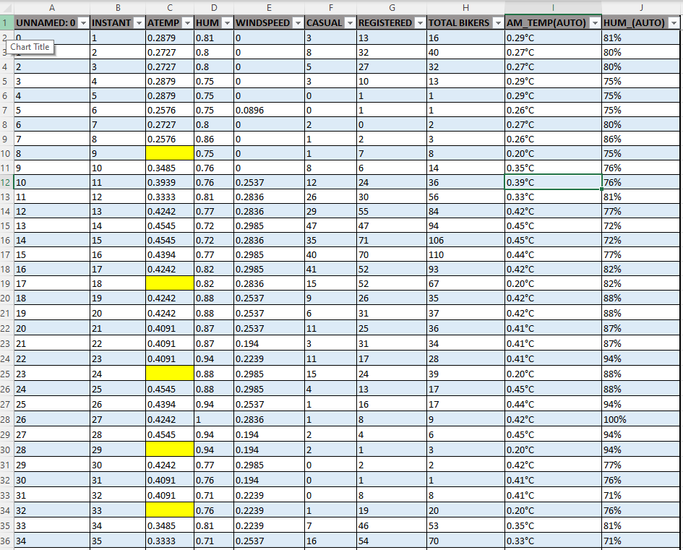
Dataset_2 – Data Cleaning & Standardization
Dataset_2 was converted into a structured table for better data handling and consistency.
Missing temperature values were assumed and filled using the same Mean (Average) method, ensuring uniformity across the dataset.
Temperature values were formatted in Degree Celsius (°C) using cell formatting.
Humidity data was converted into Percentage (%) format to improve readability and analysis accuracy.
These steps ensure standardized data, reduced missing values, and improved analytical reliability.

Slide 5
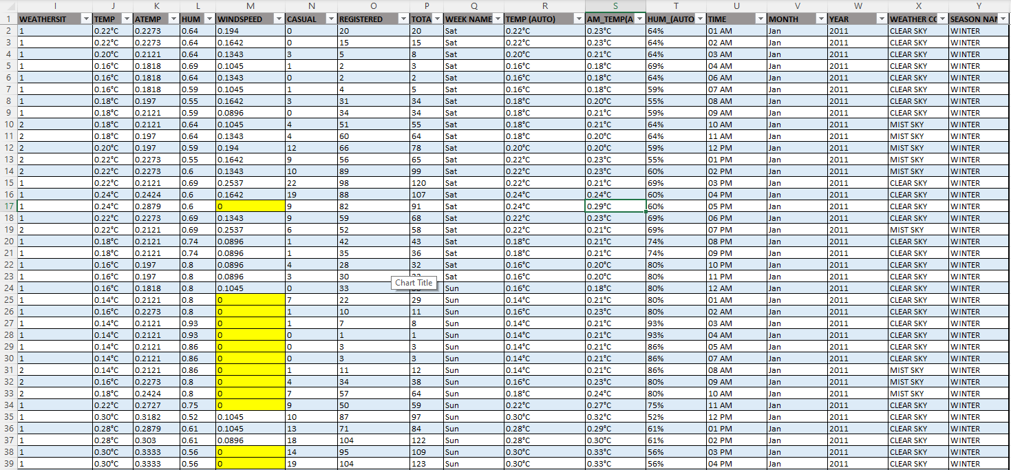
Dataset_3 – Feature Engineering & Visualization Readiness
Dataset_3 followed the same data preparation approach as Dataset_1 and Dataset_2 to maintain consistency.
The dataset contained similar data, so identical cleaning and transformation techniques were applied.
Missing humidity values were filled using the Mean (Average) method to avoid data gaps.
Additional columns such as Week Name, Weather Condition, Season, Time, Month, Year, and Date were created for enhanced analysis.
These derived columns help in better filtering, trend analysis, and perfect visualization within the dashboard.
Overall, the dataset is fully structured and analysis-ready for dynamic dashboard reporting.

Slide 6
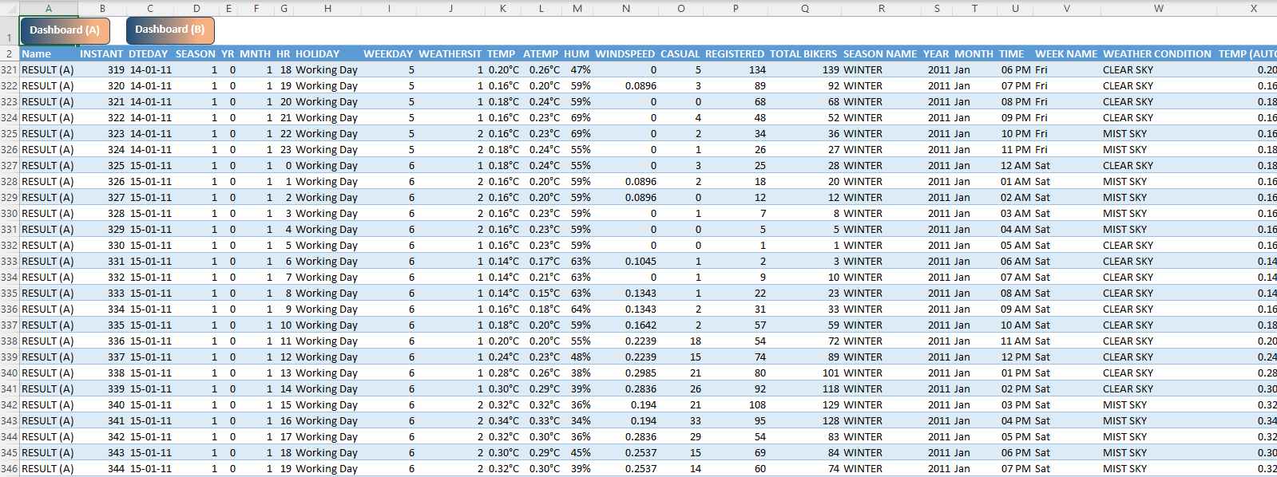
Result(A) – Power Query Transformation & Data Merging
Dataset_1, Dataset_2, and Dataset_3 were imported into Power Query for data transformation and cleaning.
After cleaning, all datasets were saved as connections only, ensuring better performance and efficient data management.
A new dataset named Result (A) was created for consolidated analysis.
Dataset_1 and Dataset_2 were merged with “full outer join” using a unique key column named “Instant” to ensure accurate data matching.
The merged dataset was then loaded as a connection, making it ready for further analysis and dashboard development.
This approach improves data accuracy, scalability, and overall analytical efficiency.

Slide 7
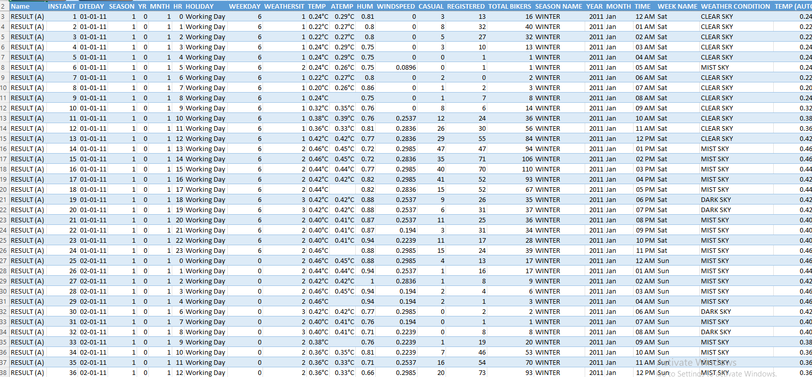
Result(B) – Data Appending & Final Feature Creation
The Result (A) dataset had the same structure as Dataset_3, so both were appended in Power Query to create a unified dataset.
Data was sorted (sequenced) to ensure that any future data additions appear in the correct order automatically.
The appended data was then loaded, creating a new dataset named Result (B).
In both Result (A) and Result (B), two additional columns were created for dashboard usability:
AM/PM extracted from the Time column for slicer-based filtering.
Day Name / Day extracted from the Date column for time-based analysis.
These enhancements improve interactivity, filtering, and clarity in the dashboard visualizations.

Slide 8
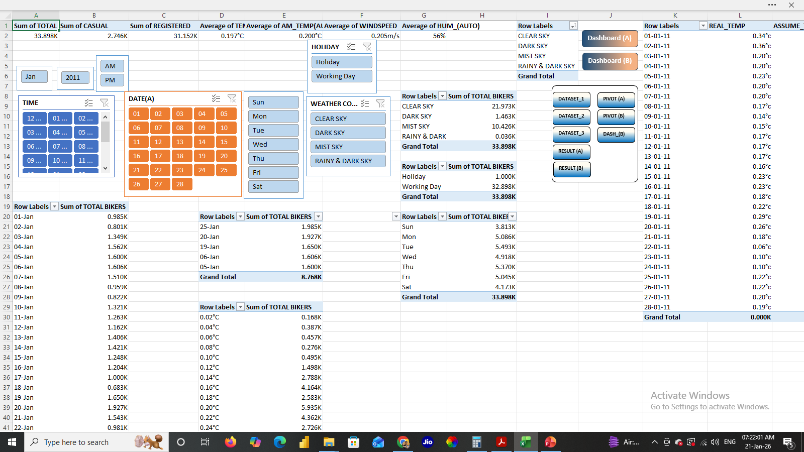
Pivot Tables & Dashboard Backend (Result A & Result B)
For both Result (A) and Result (B) dashboards, multiple Pivot Tables were created to support different analytical views.
Separate pivots were designed for report cards as well as for individual charts.
Analysis such as Temperature vs Bike Rental data and Weekend-wise trends were developed using dedicated pivot tables.
All pivot tables for each result set were organized into a single backend sheet, making it easier to manage and link visuals.
Every pivot table was linked to its corresponding chart, enabling dynamic updates through slicers and filters.
The same structured approach was replicated for Result (B) to maintain consistency across dashboards.
This method ensures clean visualization, fast refresh performance, and scalability for future data additions.

Slide 9
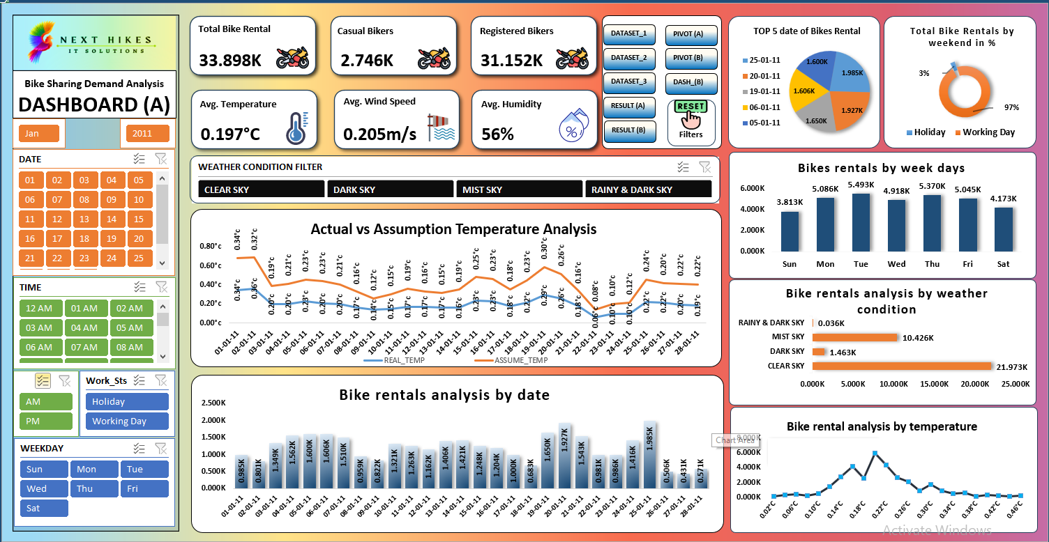
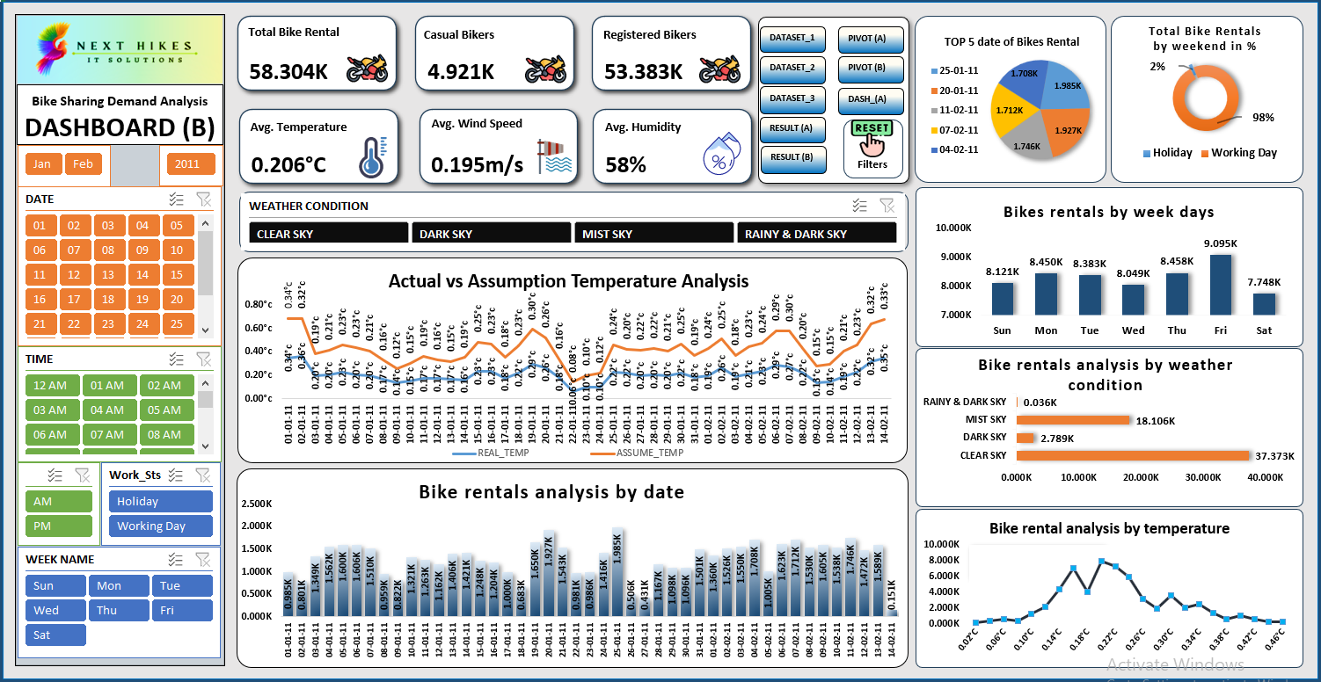
Dashboard Design & Interactivity
(Dashboard A & Dashboard B)
Two dashboards were developed: Dashboard (A) based on Result (A) data and Dashboard (B) based on Result (B) data.
Dashboard (A) follows the NextHike color theme, using a gradient background and consistent visual styling.
Dashboard (B) was designed with a different light background, giving it a clean and simple look for better readability.
Multiple slicers were implemented to analyze data from various perspectives, including:
Date-wise, Month-wise, Time-wise
Week-wise, Weekend-wise
Weather Condition-wise
KPI cards were created using icons to highlight key metrics clearly.
Various charts and visuals were developed to support detailed analysis.
A VBA Macro was implemented to reset all slicers and filters in one click.
Stable pivot connections were established to ensure consistent filtering across all visuals.
For a better and distraction-free view, sheet tabs, scroll bars, and gridlines were disabled.
All relevant sheets were connected using hyperlinks to enable smooth navigation.
The same dashboard logic and interactivity were maintained across both dashboards for consistency.

